Slide 1
CE/CS/TE 4390 Computer Networks
UT
D
application
transport
network
data link
physical
Network Application Programming – An Overview
Adapted from “Computer Networking – a Top-Down Approach”
© 1996-2012 by J.F Kurose and K.W. Ross, All Rights Reserved
Notes:
How to write a network app?
What/why/how of sockets?
How multiple net apps in a host is assigned an address?
How to use sockets in a network app using Java?

Slide 2

Socket Programming
goal: learn how to build client/server applications that communicate using sockets
socket: door between application process and end-end-transport protocol
application
socket
application
controlled by
app developer
process
process
transport
transport
network
network
controlled
by OS
link
Internet
link
physical
physical

Slide 3
Socket Programming
Two socket types for two transport services:
UDP: unreliable datagram
TCP: reliable, byte stream-oriented
Application example:
Client reads a line of characters (data) from its keyboard and sends the data to the server.
The server receives the data and converts characters to uppercase.
The server sends the modified data to the client.
The client receives the modified data and displays the line on its screen.

Slide 4
Socket Programming with UDP
UDP: no “connection” between client & server
no handshaking before sending data
sender explicitly attaches IP destination address and port # to each packet
rcvr extracts sender IP address and port# from received packet
UDP: transmitted data may be lost or received out-of-order
Application viewpoint:
UDP provides unreliable transfer of groups of bytes (“datagrams”) between client and server

Slide 5

UDP uses Datagram packets to implement connectionless packet delivery
Java classes are used DatagramPacket and DatagramSocket
DatagramPacket(byte[] buf, int length, InetAddress address, int port);
Send data: send(DatagramPacket p)
Receive data: receive(DatagramPacket p)

Slide 6
Client/server Socket Interaction: UDP
server (running on serverIP)
client
create socket:
create socket, port= x:
DatagramSocket clientSocket
= new DatagramSocket();
serverSocket =
socket(AF_INET,SOCK_DGRAM)
Create datagram with server IP and
port=x; send datagram via clientSocket
read datagram from
serverSocket
write reply to
serverSocket
specifying client address,
port number
read datagram from
clientSocket
close
clientSocket

Slide 7
Example: Java client (UDP)
import java.io.*;
import java.net.*;
class UDPClient {
public static void main(String args[]) throws Exception
{
DatagramSocket clientSocket = new DatagramSocket();
byte[] sendData = new byte[1024];
byte[] receiveData = new byte[1024];
BufferedReader inFromUser =
new BufferedReader(new InputStreamReader(System.in));
String sentence = inFromUser.readLine();
sendData = sentence.getBytes();
InetAddress IPAddress = InetAddress.getByName("hostname");
create
client socket
create
Input stream
translate
hostname to IP
address using DNS

Slide 8
Example: Java client (UDP) - cont’d
create datagram with data-to-send,
length, IP addr, port
DatagramPacket sendPacket =
new DatagramPacket(sendData, sendData.length, IPAddress, 9876);
clientSocket.send(sendPacket);
DatagramPacket receivePacket =
new DatagramPacket(receiveData, receiveData.length);
clientSocket.receive(receivePacket);
String modifiedSentence =
new String(receivePacket.getData());
System.out.println("FROM SERVER:" + modifiedSentence);
clientSocket.close();
}
}
send datagram
to server
read datagram
from server

Slide 9
Example: Java Server (UDP)
import java.io.*;
import java.net.*;
class UDPServer {
public static void main(String args[]) throws Exception
{
DatagramSocket serverSocket = new DatagramSocket(9876);
byte[] receiveData = new byte[1024];
byte[] sendData = new byte[1024];
while(true)
{
DatagramPacket receivePacket =
new DatagramPacket(receiveData, receiveData.length);
serverSocket.receive(receivePacket);
create
datagram socket
at port 9876
create space for
received datagram
receive
datagram

Slide 10
Example: Java Server (UDP) – cont’d
String sentence = new String(receivePacket.getData());
InetAddress IPAddress = receivePacket.getAddress();
int port = receivePacket.getPort();
String capitalizedSentence = sentence.toUpperCase();
sendData = capitalizedSentence.getBytes();
DatagramPacket sendPacket =
new DatagramPacket(sendData, sendData.length, IPAddress,
port);
serverSocket.send(sendPacket);
}
}
}
get IP addr
port #, of
sender
create datagram
to send to client
write out
datagram
to socket
end of while loop,
loop back and wait for
another datagram

Slide 11
Socket Programming with TCP
client must contact server
server process must first be running
server must have created socket (door) that welcomes client’s contact (ServerSocket class)
client contacts server by:
Creating TCP socket, specifying IP address, port number of server process
when client creates socket: client TCP establishes connection to server TCP
when contacted by client, server TCP creates new socket (Socket class) for server process to communicate with that particular client
allows server to talk with multiple clients
source port numbers used to distinguish clients (more in Chap 3)
new socket is used to exchange data with the client using input and output streams
application viewpoint:
TCP provides reliable, in-order
byte-stream transfer (“pipe”)
between client and server

Slide 12
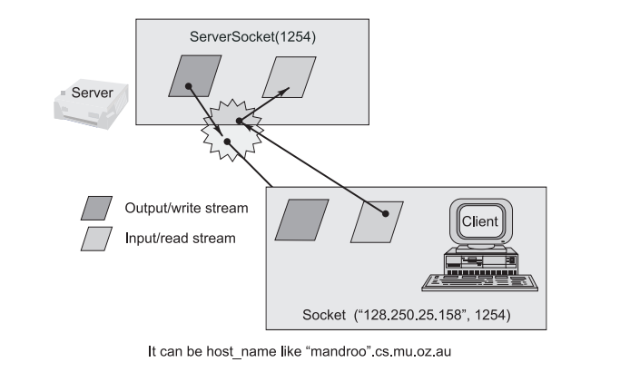
TCP Sockets based client-server programming
Reference Book:
Object-Oriented Programming with Java by Rajkumar Buyya, S Thamarai Selvi, Xingchen Chu

Slide 13
Client/server Socket Interaction: TCP
server (running on hostid)
client
create socket,
port=x, for incoming request:
ServerSocket welcomeSocket = new ServerSocket(6789);
wait for incoming
connection request
TCP
connection setup
create socket,
connect to hostid, port=x
connectionSocket =
welcomeSocket.accept()
clientSocket = socket()
send request using
clientSocket
read request from
connectionSocket
write reply to
connectionSocket
read reply from
clientSocket
close
connectionSocket
close
clientSocket

Slide 14
Example: Java Client (TCP)
import java.io.*;
import java.net.*;
class TCPClient {
public static void main(String argv[]) throws Exception
{
String sentence;
String modifiedSentence;
BufferedReader inFromUser =
new BufferedReader(new InputStreamReader(System.in));
Socket clientSocket = new Socket("hostname", 6789);
DataOutputStream outToServer =
new DataOutputStream(clientSocket.getOutputStream());
This package defines Socket()
and ServerSocket() classes
server name,
e.g., www.umass.edu
server port #
create
input stream
create
clientSocket object
of type Socket,
connect to server
create
output stream
attached to socket

Slide 15
Example: Java client (TCP) – cont’d
create
input stream
attached to socket
BufferedReader inFromServer =
new BufferedReader(new
InputStreamReader(clientSocket.getInputStream()));
sentence = inFromUser.readLine();
outToServer.writeBytes(sentence + '\n');
modifiedSentence = inFromServer.readLine();
System.out.println("FROM SERVER: " + modifiedSentence);
clientSocket.close();
}
}
send line
to server
read line
from server
close socket
(clean up behind yourself!)

Slide 16
Example: Java server (TCP)
import java.io.*;
import java.net.*;
class TCPServer {
public static void main(String argv[]) throws Exception
{
String clientSentence;
String capitalizedSentence;
ServerSocket welcomeSocket = new ServerSocket(6789);
while(true) {
Socket connectionSocket = welcomeSocket.accept();
BufferedReader inFromClient =
new BufferedReader(new
InputStreamReader(connectionSocket.getInputStream()));
create
welcoming socket
at port 6789
wait, on welcoming
socket accept() method
for client contact create,
new socket on return
create input
stream, attached
to socket

Slide 17
Example: Java Server (TCP) – cont’d
DataOutputStream outToClient =
new DataOutputStream(connectionSocket.getOutputStream());
clientSentence = inFromClient.readLine();
capitalizedSentence = clientSentence.toUpperCase() + '\n';
outToClient.writeBytes(capitalizedSentence);
}
}
}
create output
stream, attached
to socket
read in line
from socket
write out line
to socket
end of while loop,
loop back and wait for
another client connection

